Slide 1

Efficacy of Piperazine citrate, Levamisole hydrochloride and Albendazole in the Treatment of Chickens naturally infected with Gastrointestinal Helminths
Presented at the 47TH ANNUAL SCIENTIFIC CONFERENCE ON “ONE HEALTH APPROACH IN VETERINARY TRAINING AND PRACTICE” ON 24TH TO 26TH APRIL 2013 AT THE WHITESAND HOTEL, MOMBASA
By
HANNAH W CHEGE
DEPARTMENT OF VETERINARY PATHOLOGY, MICROBIOLOGY AND PARASITOLOGY
University of Nairobi

Slide 2
Introduction
Endo and ecto- parasites are common among indigenous chickens since they are kept outdoors where they scavenge and forage and in the process pick up the infective stages of the parasites.
Heavy parasite burdens have been recorded in indigenous chicken in Eastern Province of Kenya (Sabuni, 2009)
Anthelmintic intervention in Kenya often involves medication with piperazine, tetramisole and oxfendazole.

Slide 3
Introduction cont.......
Previous studies
20mg/kg body weight of albendazole has been reported to clear larval and adult stages of Ascaridia galli, Heterakis gallinarum, Capillaria obsignata and Raillietina cesticillus (Tucker et al., 2007).
  Levamisole at a dose of 48mg/kg body weight is reported to be 100% efficacious against Heterakis gallinarum(Cruthers et al., 1975).
  It is therefore necessary to determine the effectiveness of various anthelmintics that can be used in village chickens for effective control of endoparasites.

Slide 4
Materials and methods
Experimental birds
Thirty adult village chickens were purchased from individual farmers in Mbeere District and were transported to Kabete campus, UON for the study.
Five adult birds were sacrificed before start of the experiment, to ascertain presence and types of parasites(Charlton et al., 2006 )
Antiparasitic treatments
Before the start of experiment, 19 Questionnaires were administered to evaluate antiparasitic treatment farmers used.

Slide 5
Cont...of materials and methods
Experimental design
The chickens were allowed to acclimatize for three days and on day 4 they were randomly allocated to four treatment groups(Table 1; Figure 1).
Chickens were kept separately in cages where faecal samples were collected three times per day and screened for parasite eggs(Figure 2)

Slide 6
Cont...of materials and methods
Group of chickens | Anthelmintic used | Number of chickens
1 | Ascarex (Piperazine citrate) | 7
2 | Levamisole HCL | 7
3 | Albendazole | 7
4 | Control | 9
Table 1: Experimental chicken groups and anthelmintic treatments

Slide 7
Albendazole (Ultravetis) 20mg/kg bwt.-Highest bird weight used weighed 2.5kgs(0.5mls of Albendazole administered orally once)
7.5 litres of Levamisole HCL(25mg/kg bwt)(Biodeal) – put in 3liters of drinking water and each bird given 430mls of medicated water
Three quarter tea spoonful(4.5gm) of Piperazine citrate(Cosmos)-dissolved in 3 litres of water each bird given 430mls of medicated water

Slide 8
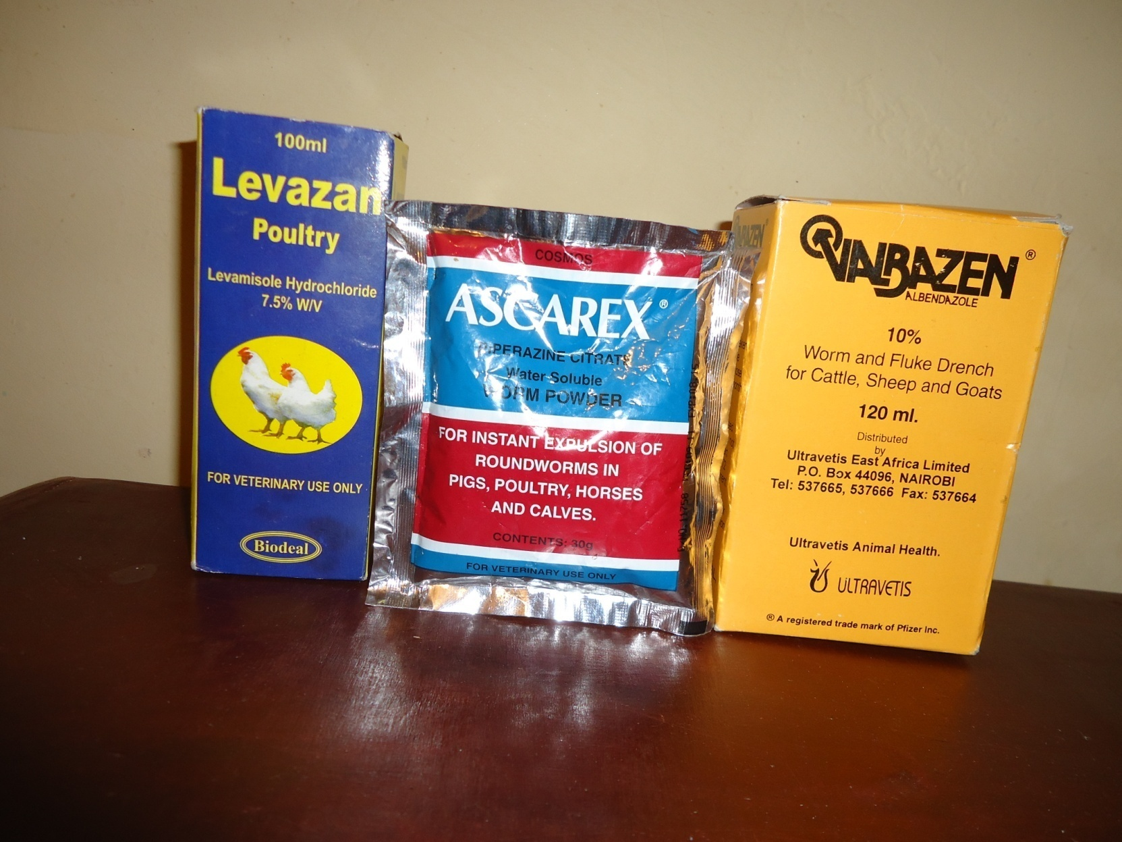
Figure 1 : Levamisole HCL, Piperazine citrate and albendazole

Slide 9
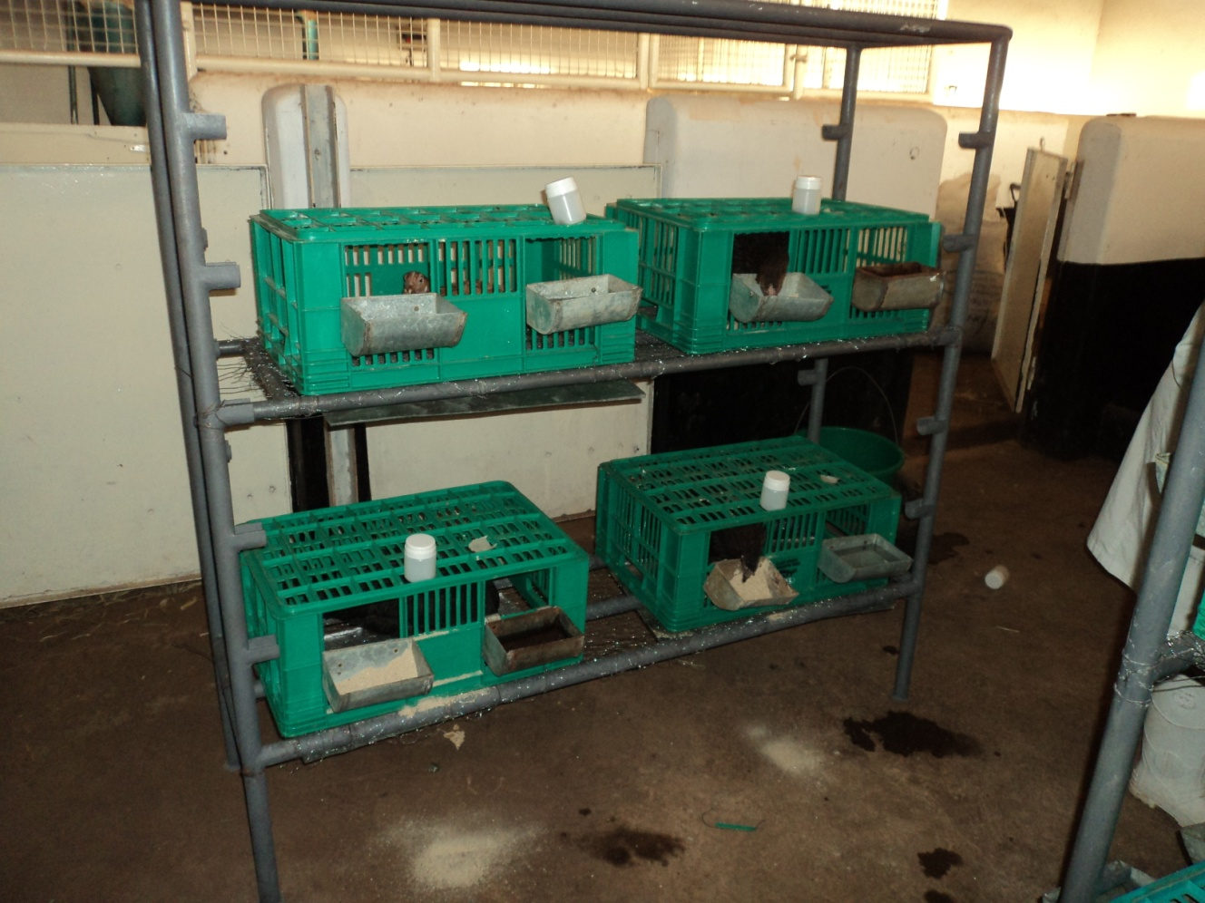
Cont...of materials and methods
Faecal pots
chicken
Faecal tray
chicken
Feeding and watering trough
Figure 2: chickens caged differently, faecal pots, feeding and watering trough during the experiment

Slide 10
Cont...of materials and methods
Fecal egg count and identification.
This was done three times per day at 8am, 12noon and 5 pm in the evening for 10 days (MAFF, 1986)
Parasite recovery and identification
At the end of experiment all the chickens were sacrificed and necropsy undertaken to check the presence of the endoparasites (Charlton et al., 2006).
Parasites recovered were identified in accordance with the helminthologic keys of-Soulsby 1982, Permin and Hansen 1998
.
`

Slide 11
Effectiveness of the anthelmintic drugs
Efficacies of the anthelmintics were evaluated by
a) Complete reduction in number of eggs in treated birds
b)Percentage effectiveness against each parasite species (or stage) was determined using the formula by Yazwinski et al . (2003).
% effectiveness=
mean no. of worms in controls- mean no. of worms in treated animal × 100
mean no. of worms in controls
Key: %=percentage, no. =number

Slide 12
The means of helminth population for each treatment group were used to calculate the percentage efficacy of the anthelmintics. (Table 2).
Percentage efficacies for the different anthelmintics were considered effective above 90 %.

Slide 13
Results and discussion
The five birds sacrificed before treatment had caecal worms, Tetrameres species and cestodes (Railletina tetragona and Railletina echinobothrida).
Out of the thirty chickens, two chickens shed Heterakis species egg
One chicken shed Ascaridia galli eggs (Figure 2)
The chickens shed the eggs more in the morning than in the noon and evening. The shedding of the eggs was completely reduced two days after the treatment.
Only 7 birds( those treated with albendazole) shed the worms in faeces after treatment)

Slide 14
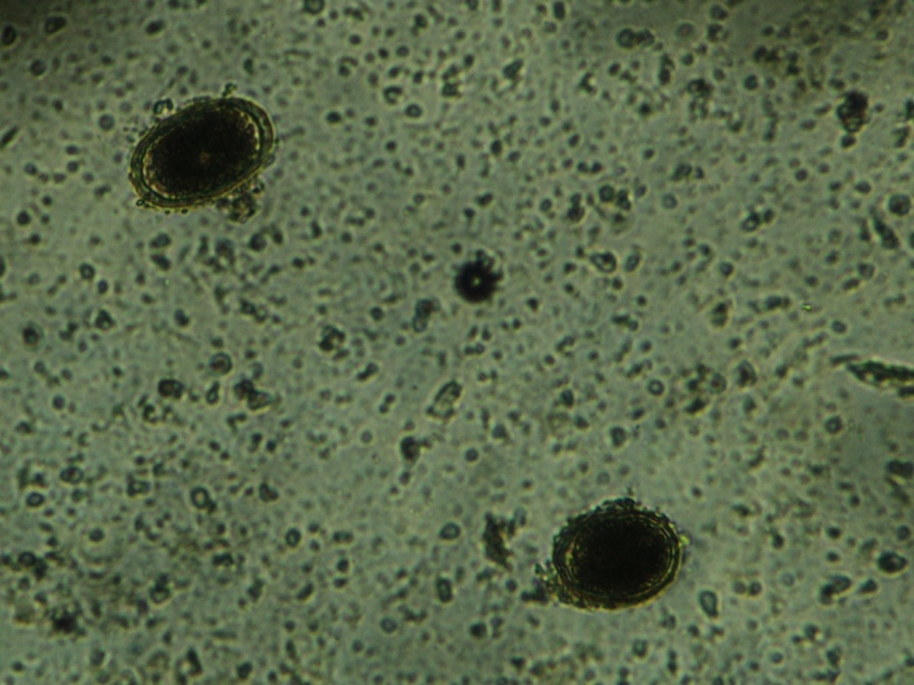
Control group birds and those treated with Piperazine citrate and Levamisole HCL did not shed the worms
Heterakis species
Ascaridia galli
Figure 2: Heterakis species (H) and Ascaridia galli eggs(A) isolated from chicken faecal samples

Slide 15
Helminth | Piperazine citrate | Levamisole HCL | Albendazole
Heterakis species | 59.16% | 100% | 100%
Heterakis isolonche | 58.44% | 100% | 100%
Subulura brumpti | 55.71% | 100% | 100%
Tetramere species | 11.18% | 69.84% | 100%
Railletina tetragona | 13.44% | 25.59% | 100%
Railletina echnobothrida | 49.46% | 17.62% | 100%
Table 2: Percentage efficacies for the different anthelmintics

Slide 16
Piperazine citrate was not effective against cestodes (Railletina species), caecal worms Heterakis species, Subulura brumpti) and Tetrameres hence high parasite carriage but it effective against Ascaridia galli which was only present in one chicken.
Oral interview,> Few farmers( 17.65%) seemed to take Piperazine as the only commercial anthelmintic they ever heard of hence, the reason for not recovering ascarids (unpublished questionnaire results)

Slide 17
Levamisole HCL 25mg/kg was 100% effective against the caecal worms .It had very little efficacy of 25.59% and 17.62% against cestodes Railletina echnobothrida and R. tetragona respectively and 62.84% efficacy against Tetrameres
>Other studies in Sudan (Thienpoint et al., 1966; Jansen(1976), found that Levamisole HCL did not have any anthelmintic efficacy against tapeworms >this work has not been published in Kenya.
>Contrary to the previous findings where Levamisole at a dose of 48mg/kg bwt reported to be 100% efficacious against Heterakis gallinarum

Slide 18
Albendazole at 20mg/kg body weight was 100% effective against Heterakis species, H.isolonche, Subulura brumpti, Tetrameres, Railletina tetragona and Railletina echnobothrida.
>Other studies in Arkansas, United States (Tucker et al., 2007) reported that Albendazole at 20mg/kg body weight was effective against Ascaridia galli, Capillaria obsignata, Heterakis gallinarum and Raillietina cesticillus but they did not report on Subulura brumpti, Tetrameres and the two species of tapeworms reported in this study.

Slide 19
Conclusions
Albendazole at 20mg/kg BW was the most effective with respect to treatment of both cestodes, roundworms (and ascarids). The use of albendazole is, therefore, recommended to ensure total control of worms.
Levamisole HCL is recommended for birds diagnosed with caecal worms only
Piperazine is recommended for birds with Ascarids only.
There was no correlation between the faecal egg counts and the worm burden.
Acknowledgement
The authors thank RUFORUM for their sponsorship and funding of the project,
University of Nairobi for providing the work space and facilities,
Richard Otieno, Rose Nyawira and Rebecca Githinji for their technical assistance
The farmers of Mbeere for their cooperation
The present audience for listening to me

Slide 20
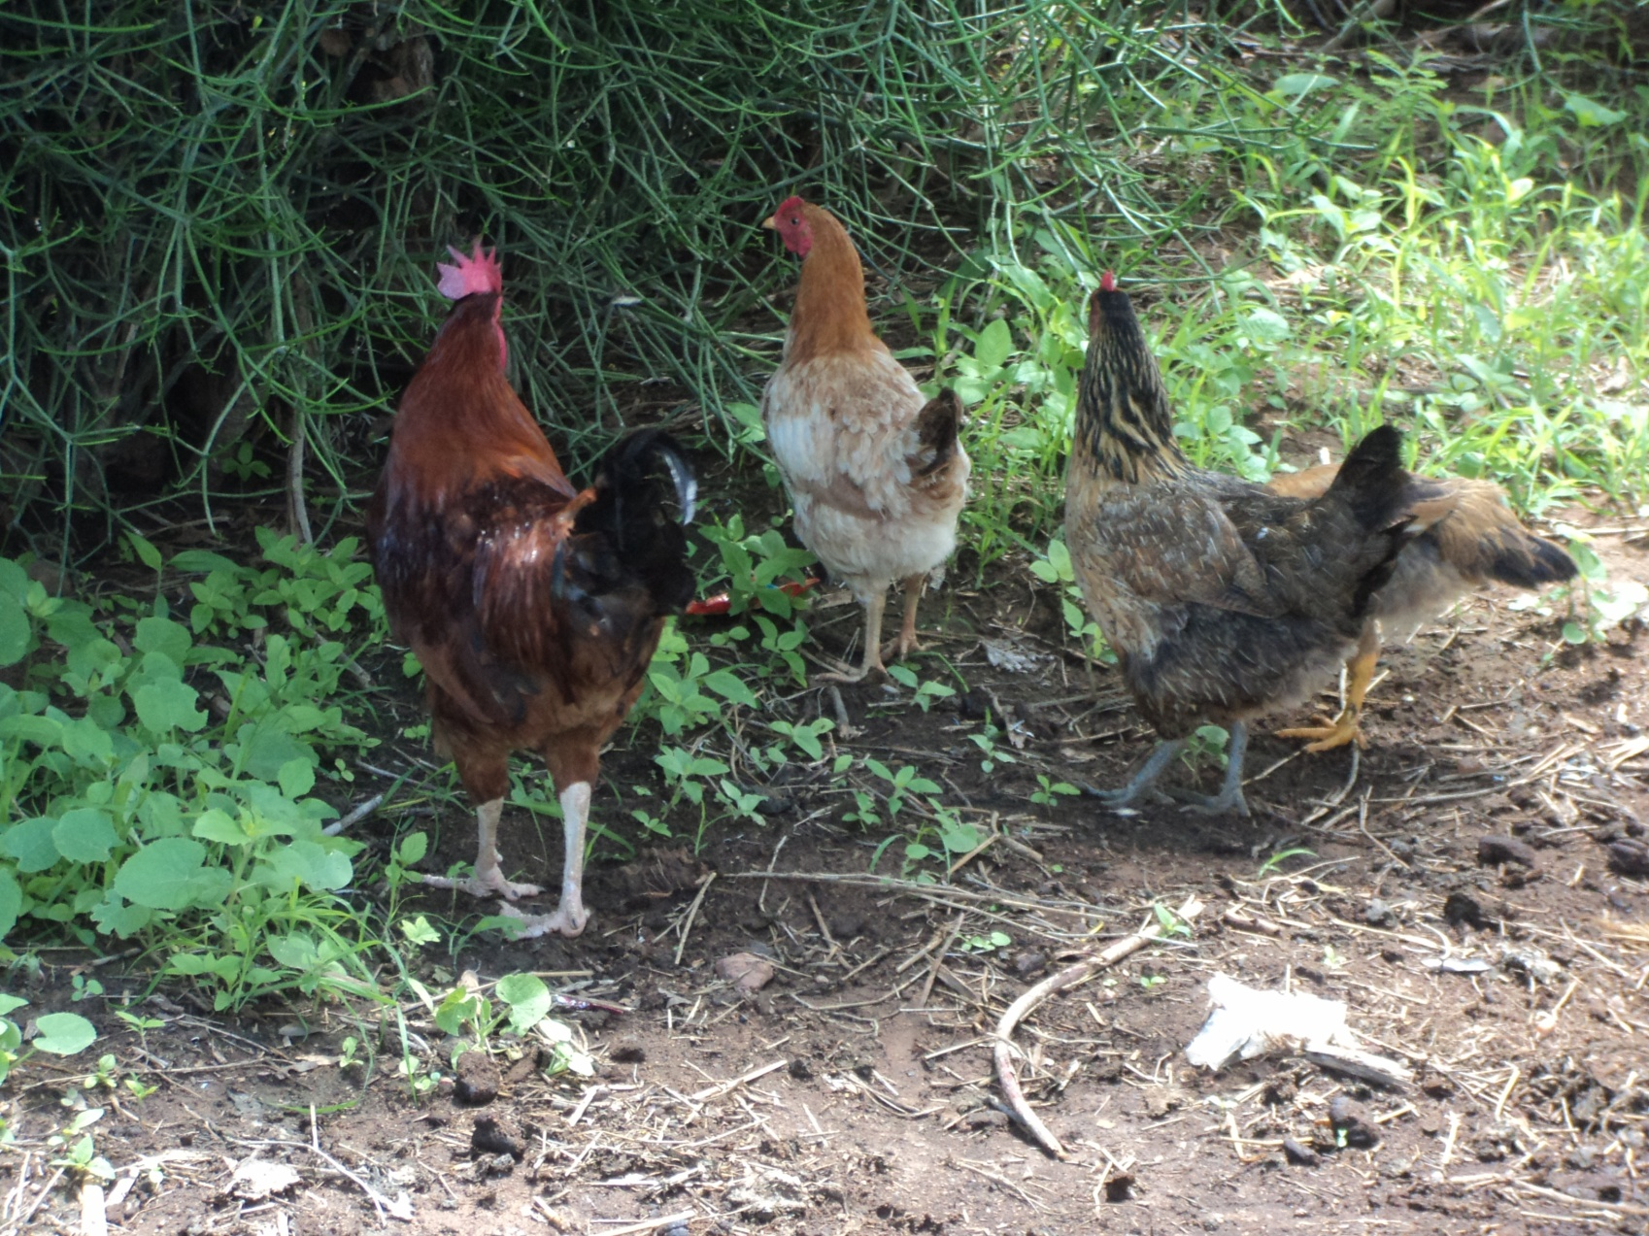
THANKS

