Slide 1

poultry parasites and control
Presented at the “Enhancing chicken productivity through parasite management for effective Newcastle disease vaccination in Kenya – Mbeere Stakeholders workshop on 4th December 2013”
By
HANNAH W CHEGE
DEPARTMENT OF VETERINARY PATHOLOGY, MICROBIOLOGY AND PARASITOLOGY
University of Nairobi

Slide 2
Introduction
Poultry production is a growing and an economically important industry in Kenya.
Endo and ecto- parasites are common among indigenous chickens since they are kept outdoors where they scavenge and forage and in the process pick up the infective stages of the parasites.
Effects of parasites include: *competition for nutrients
*sucking blood causing anaemia
*diarrhoea and/or obstruction of intestines.
This leads to lowered productivity (reduction in weight gain, decreased egg production) and/or mortality.

Slide 3
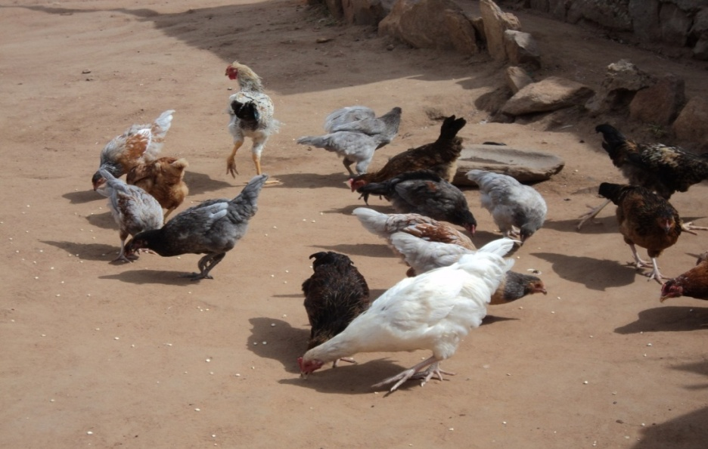
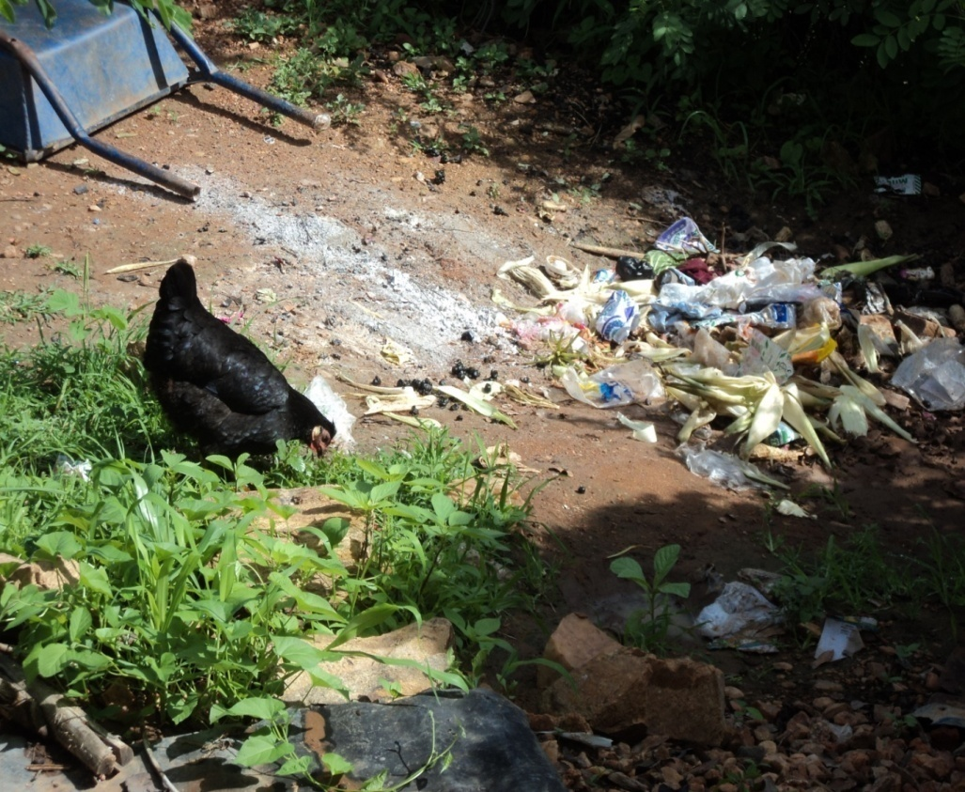
Cont….introduction
Fig 2: Village chickens scavenging in the field
Fig 1: Village chicken of various ages
Previous study>> Heavy parasite burdens have been recorded in indigenous chicken in Eastern Province of Kenya (Sabuni, 2009).

Slide 4
Introduction cont.......
20mg/kg body weight of albendazole shown to clear larval and adult stages of Ascaridia galli, Heterakis gallinarum, Capillaria obsignata and Raillietina cesticillus (Tucker et al., 2007).
  Levamisole (48mg/kg bwt) been reported >>100% efficacious against Heterakis gallinarum(Cruthers et al., 1975).
  The present study was carried out to determine
  a)The occurrence, types and intensity of ecto-and endo-parasites in chicken during different seasons in Mbeere District.
  b)the effectiveness of various anthelmintics that can be used in village chickens for effective control of endoparasites.

Slide 5
Materials and methods
Study area>> Study conducted in Mbeere district, Kenya>> has a high poultry population.
>> For seasonality >>>total of 48 chicken (chicks, growers and adults) randomly selected and purchased from farms (24 in wet season and 24 in dry season).
Post-mortem examination of birds was done (Charlton et al 2006).
Ectoparasites were examined and identified following (described by Sabuni , 2009).
>>For effectiveness>>Thirty seven adult village chickens were purchased were transported to Kabete campus, UON for the study to evaluate the effectiveness of selected anthelmintics.

Slide 6
Chicken were caged differently, screened for parasite eggs and allowed to acclimatize for 3 days.
Chicken were divided into 4 treatment groups as shown below.
Group of chicken | Anthelmintic used | Number of chicken
1 | Ascarex (Piperazine citrate) | 7
2 | Levamisole HCL | 7
3 | Albendazole | 7
4 | Control | 9

Slide 7
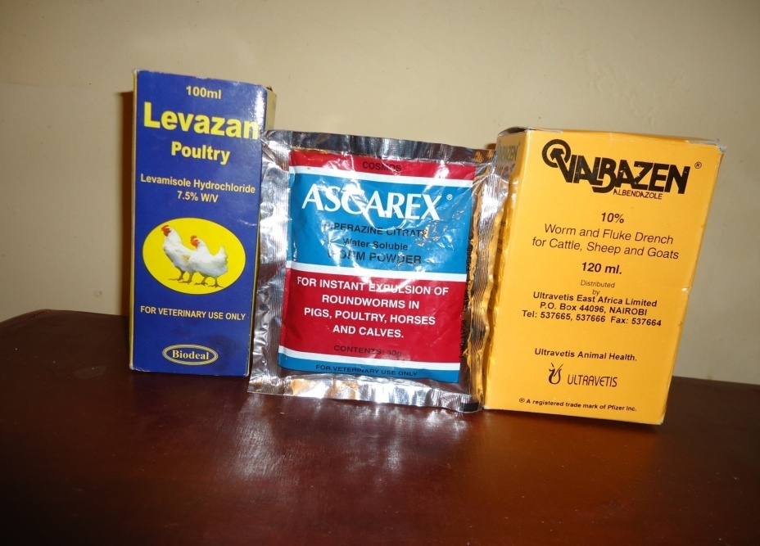
Albendazole 20mg/kg bwt-Highest bird weight used weighed 2.5kgs(0.5mls of Albendazole administered orally once).
7.5 litres of Levamisole HCL 25mg/kg bwt– put in 3liters of drinking water and each bird given 430mls of medicated water.
Three quarter tea spoonful(4.5gm) of Piperazine citrate at 3 mg/kg -dissolved in 3 litres of water each bird given 430mls of medicated water.
    Fig 3: Levamisole HCL, Piperazine citrate and albendazole

Slide 8
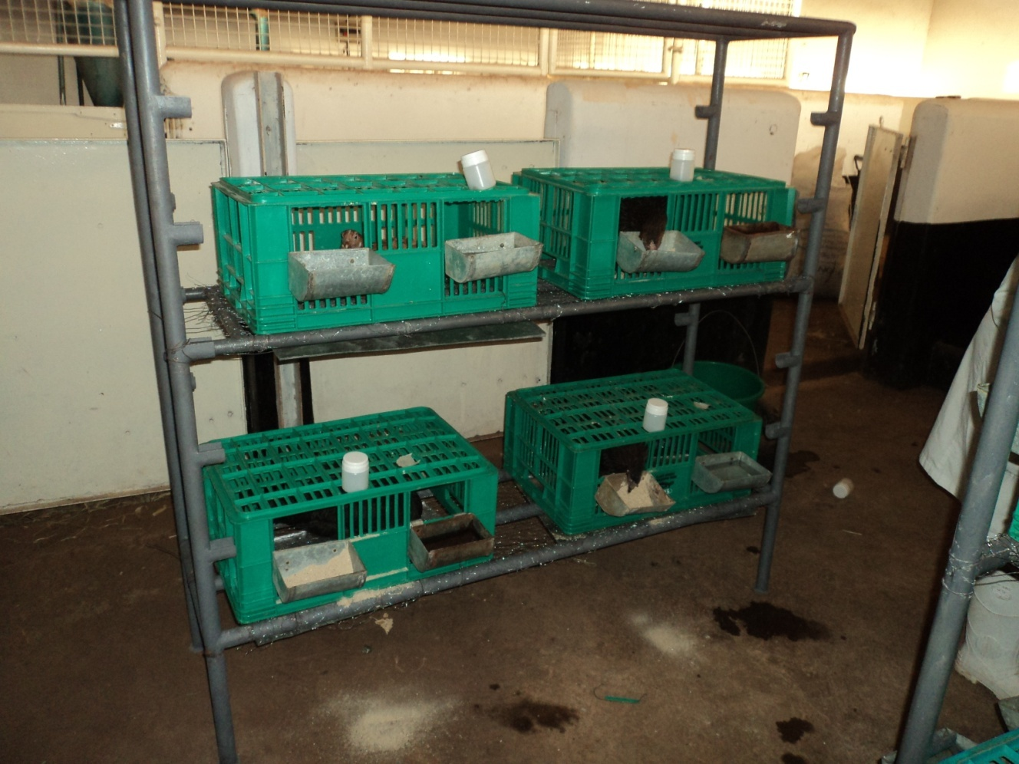
Faecal pots
chicken
Faecal tray
chicken
Feeding and watering trough
Fig 4: chicken caged differently, faecal pots, feeding and watering trough during the experiment

Slide 9
Efficacies of the anthelmintics were evaluated by
a) Complete reduction in number of eggs in treated birds
b)Percentage effectiveness against each parasite species (or stage) was determined using the formula by Yazwinski et al . (2003).
% effectiveness=
mean no. of worms in controls- mean no. of worms in treated animal × 100
mean no. of worms in controls
Key: %=percentage, no. =number
Percentage efficacies for the different anthelmintics were considered effective above 90 %.
Post -mortem examination for parasites was done 7 days post- treatment.

Slide 10
Results and discussion
High prevalences of ecto- and endoparasites ( Maina, 2005; Sabuni , 2009; Mungube et al 2008). No difference in occurrence of parasites in wet and dry season (contrary to Mungube et al., 2008).
All chicken of all the age groups in the 2 seasons had endoparasites, while ecto-parasites were found in all chicken in wet season and 95.8% of the chicken in dry season
>>In both the dry and wet seasons all birds (100%) had endoparasites. Ectoparasites were found in all the birds during the wet season and in 95.83% of the birds in the dry season
>>Birds roam around in the village hence in continuous contact with the parasites or the intermediate hosts of the parasites.
`

Slide 11
Cont….results
>>Lack of control measures against the parasites is also likely to have contributed to the high load of parasites (Mungube et al., 2008).
Endoparasites
 | Wet season | Dry season
Nematodes | 95.8% | 87.5%
Cestodes | 87.5% | 83.3%
Coccidia | 20.8% | 0%
Haemoparasites | 79.2% | 62.5%
>>Nematodes were the most prevalent endoparasites. Nematodes included caecal worms, Tetrameres americana and Gongylonema ingluvicola
>> Cestodes were mainly Raillietina echinobothrida and R.tetragona
Haemoparasites were Plasmodium gallinaceum, Leucocytozoon schoutedeni, Eperythrozoon species and Aegyptinella pullorum.

Slide 12
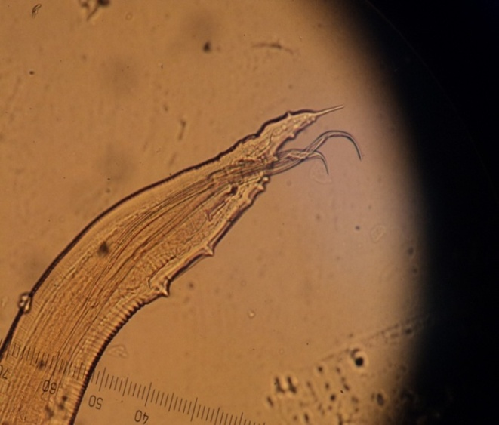
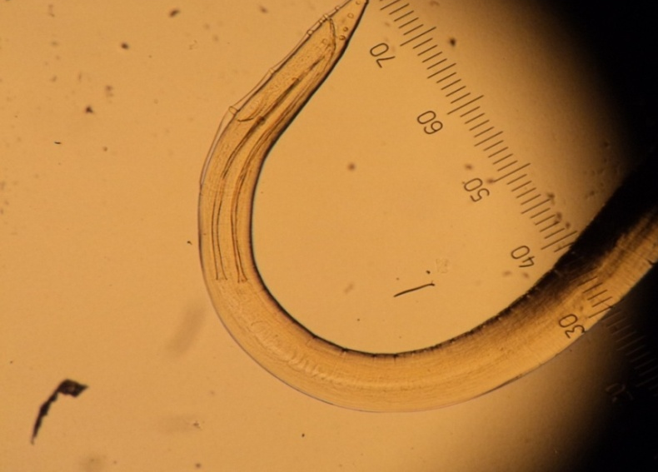
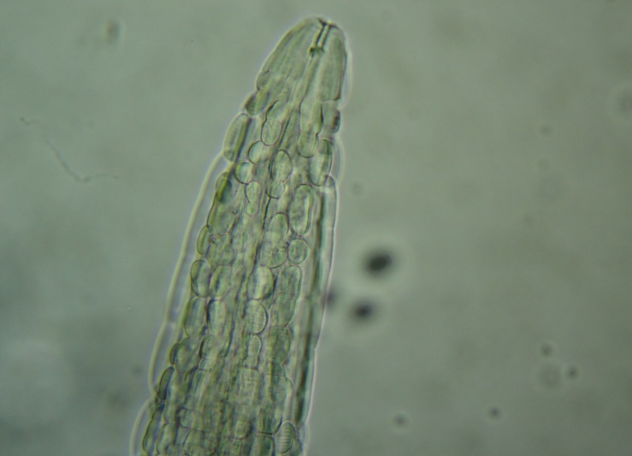
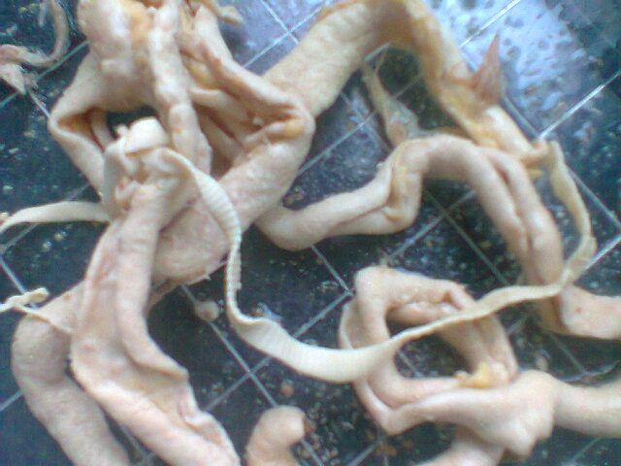
Examples of endoparasites
Fig 5: Male Heterakis isolonche with two equal spicules
Fig 6: Male Subulura brumpti with two equal spicules
Fig 7:Gongylonema ingluvicola-showing bosses
Fig 8: Tapeworm infestation in chickens

Slide 13
continuation of results
Ectoparasites isolated were lice, fleas, ticks and mites . They were found in all the age groups
Ectoparasite | Wet season | Dry season
Lice | 100% | 79.17%
Mites | 70.83% | 54.17%
Ticks | 25% | 41.67%
fleas | 62.5% | 29.17%
>> Lice were the most prevalent ecto-parasite in both seasons (Sabuni et al., 2010 )
Most prevalent louse in both season was Menacanthus stramineus
Most farmers used Cabaryl (Sevin^{R}) which is not effective against the lice (Permin and Hansen, 1998).

Slide 14
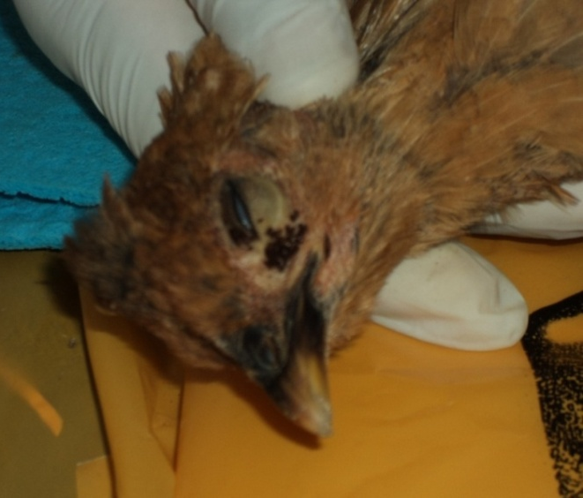
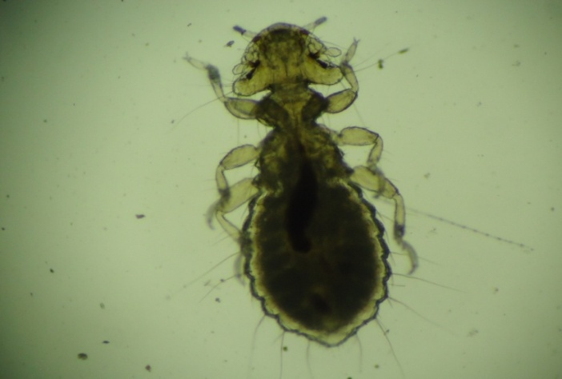
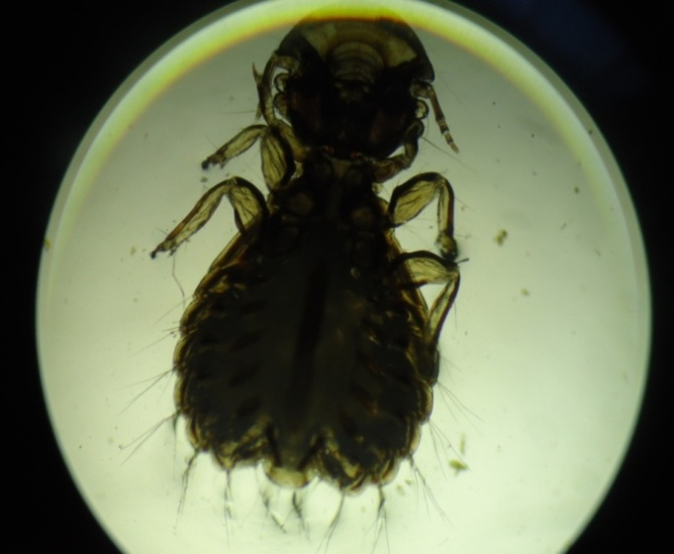
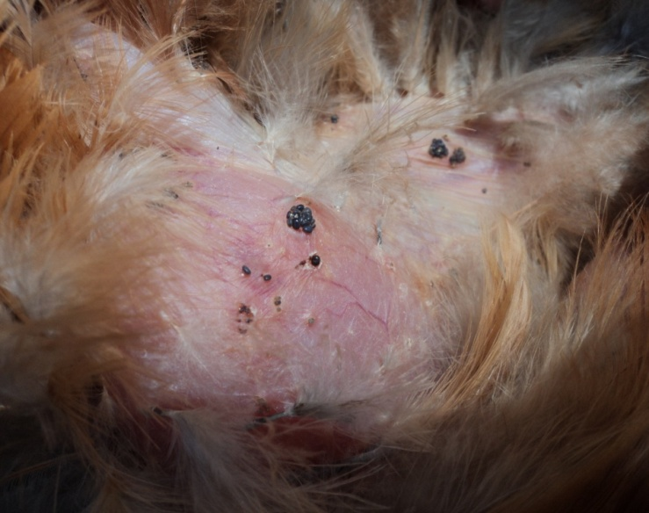
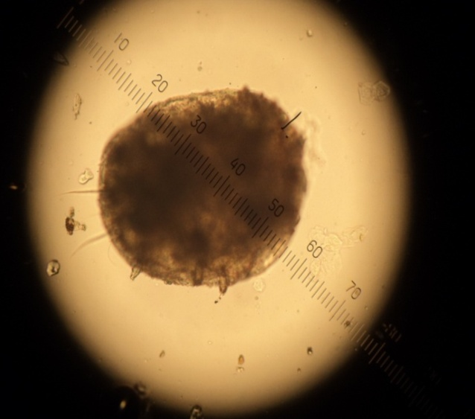
Examples of ectoparasites
Fig 10: lice
Fig 9: Flea infestation in chickens
Menacanthus
stramineus
Gonoides gigas
Fig 11: Tick: Argas persicus
Fig 12: Knemidocoptes mutans

Slide 15
Percentage efficacies for the different anthelmintics.
.
Helminth | Piperazine citrate | Levamisole HCL | Albendazole
Heterakis species | 59.16% | 100% | 100%
Heterakis isolonche | 58.44% | 100% | 100%
Subulura brumpti | 55.71% | 100% | 100%
Tetrameres americana | 11.18% | 69.84% | 100%
Railletina tetragona | 13.44% | 25.59% | 100%
Railletina echnobothrida | 49.46% | 17.62% | 100%
>> Albendazole was 100% effective against most of the helminths caecal worms (Heterakis species, Subulura brumpti) Tetrameres americana, Tapeworms(Raillietina tetragona and Raillietina echinobothrida) .

Slide 16
Piperazine citrate was not effective against cestodes (Raillietina species), caecal worms Heterakis species, Subulura brumpti) and Tetrameres americana.
Levamisole HCL 25mg/kg was 100% effective against the caecal worms .
>>had little efficacy of 25.59% and 17.62% against cestodes Raillietina echinobothrida and R. tetragona respectively and 62.84% efficacy against Tetrameres americana.

Slide 17
Conclusion
>> In wet and dry seasons no difference in parasite prevalence therefore farmers should control the parasites in both seasons.
>> The use of albendazole at 20mg/kg BW is, therefore, recommended to ensure total control of worms.
>>Levamisole HCL is recommended for birds diagnosed with caecal worms only
>>Piperazine is recommended for birds with Ascarids only.

Slide 18
Acknowledgement
RUFORUM for their sponsorship and funding of the project,
University of Nairobi for providing the work space and facilities,
Richard Otieno, Rose Nyawira and Rebecca Githinji for their technical assistance
The farmers of Mbeere for their cooperation

Slide 19
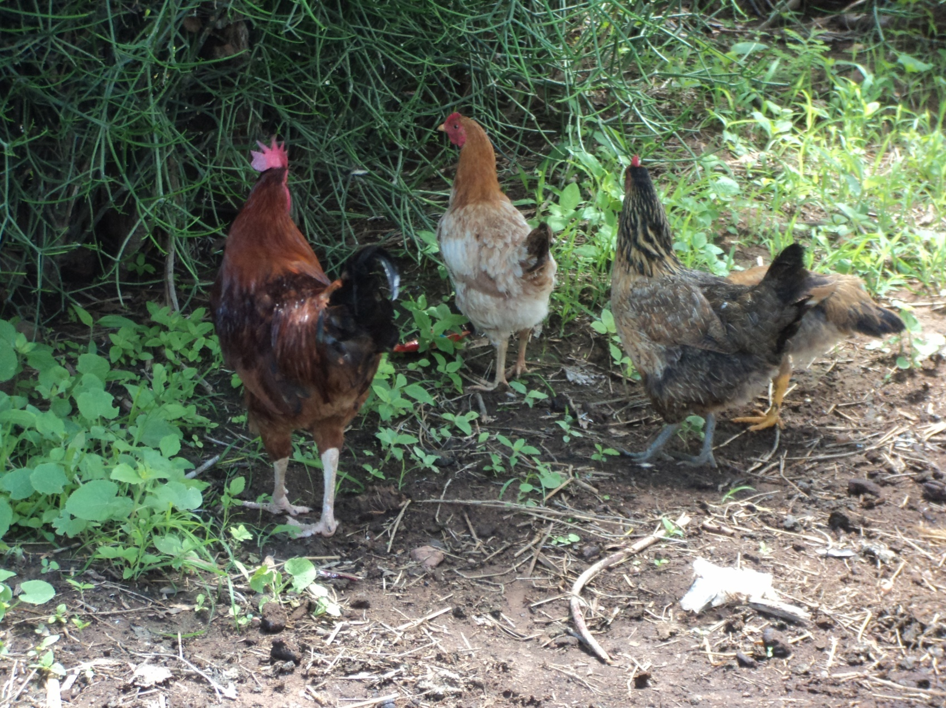
THANKS

