Slide 1
STUDY ON EFFECT OF PARASITE CONTROL ON IMMUNE RESPONSE TO NEWCASTLE DISEASE VACCINATION BY VILLAGE CHICKEN, MBEERE DISTRICT
PRESENTED AT THE 47TH ANNUAL SCIENTIFIC CONFERENCE ON “ONE HEALTH APPROACH IN VETERINARY TRAINING AND PRACTICE” ON 24TH TO 26TH APRIL 2013 AT THE WHITESAND HOTEL, MOMBASA
BY
DAVID C KEMBOI
DEPARTMENT OF VETERINARY PATHOLOGY, MICROBIOLOGY AND PARASITOLOGY
UNIVERSITY OF NAIROBI

Slide 2
Introduction
Free-range poultry keeping is the most common type of poultry production system in Kenya.
Though they have low production levels compared to their exotic counterparts (Yongolo et al., 1997)
Newcastle disease (ND) is documented among the most important diseases in the world, causing devastating losses in both commercial and village chickens
As a viral disease; it can only be effectively controlled through vaccination.

Slide 3
Parasites have a tendency of causing stress to the birds through nutrient consumption, blood sucking and irritation; have also been isolated at high levels from chickens from this area. (Prevalence at a range of 90 – 96% (Maina, 2005; Sabuni, 2009))
Stress has been reported to cause immunosuppression (Njagi et al., 2010a).
This study was carried out to check on the extent to which these parasites (ecto- and endo-) may suppress immune response to ND vaccination.
This was done through monitoring of antibody titers after selective parasite treatments followed by ND vaccination.

Slide 4
MATERIALS AND METHODS
Experimental birds
Seventy two chickens from a population that was confirmed to be infected with ecto- and endo-parasites, with no previous history of vaccination or worm control, were used in this study.
They were given two weeks to acclimatize, during which period the pre-experiment parasitic and ND antibody titer levels were established by sacrificing eight (8) randomly selected birds and carrying out post-mortem examination; this was to ascertain that the birds had parasites
The birds were found to harbour lice, helminths and coccidia and this was used to divide the remaining birds into eight different groups of 8 birds each, as given in Table 1.

Slide 5
Table 1: Experimental groups, with respect to parasite treatment, coccidia treatment and vaccination
Group of chicken | No. of chicken | Endoparasites treatment | Ectoparasites treatment | ND vaccination | Coccidia treatment
1 | 8 | - | - | - | Tolrazuril (Intracox)
2 | 8 | Albendazole | - | - | Tolrazuril (Intracox)
3 | 8 |  | Sevin+permethrin | - | Tolrazuril (Intracox)
4 | 8 | Albendazole | Sevin+permethrin | - | Tolrazuril (Intracox)
5 | 8 | Albendazole | - | + | Tolrazuril (Intracox)
6 | 8 | - | Sevin+permethrin | + | Tolrazuril (Intracox)
7 | 8 | Albendazole | Sevin+permethrin | + | Tolrazuril (Intracox)
8 | 8 | - | - | - | -

Slide 6
Treatment and vaccination
Ectoparasites treatment: Sevin+permethrin (Dusting)
Helminth treatment: Albendazole (dosage of 20mg/kg body weight via drenching)
Coccidia treatment: Intracox® (Tolrazuril 25mg) (Drinking water)
ND Vaccination: Avivax-F from Kenya Veterinary Vaccine Production Institute (primary vaccination on day 0, a booster 14 days later, followed by another booster 1 month later)
Blood was collected on weekly basis for six weeks and serum tested using Hemagglutination inhibition was carried out as described by OIE (2000)

Slide 7
Examination and identification of the parasites
All the helminths were examined under light microscope and were identified on the basis of helminthological keys described by Soulsby (1982) and Permin and Hansen (1998).
Ectoparasites were examined and identified following the method and criteria described by Sabuni (2009).

Slide 8
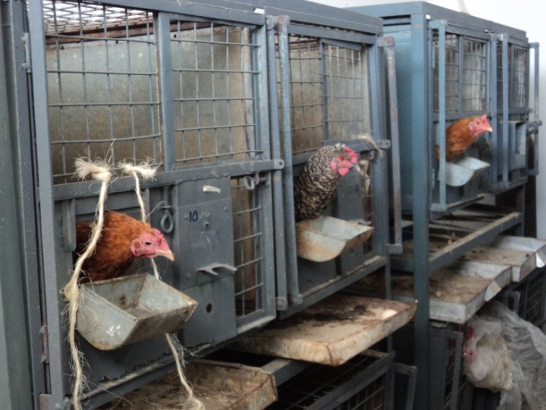
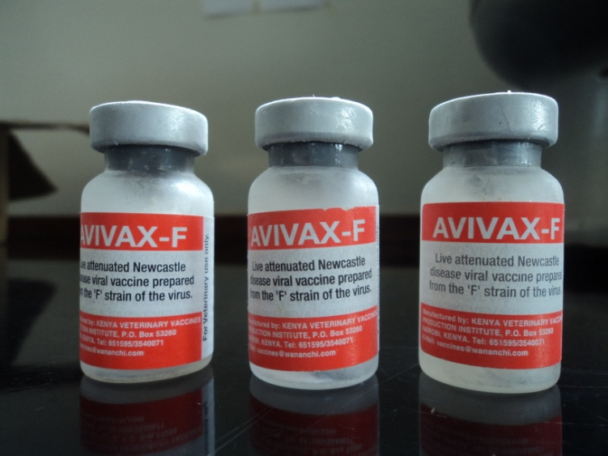
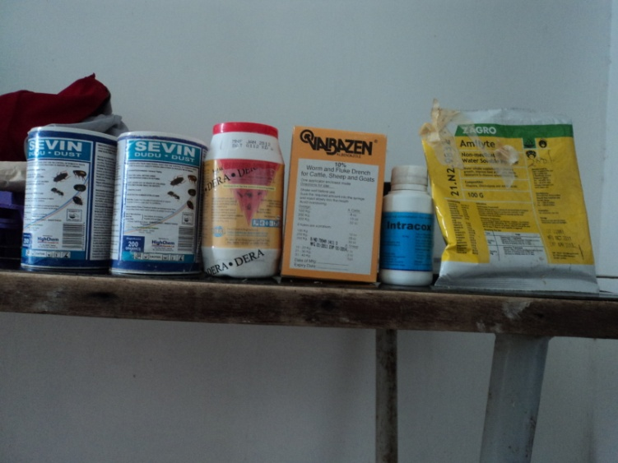
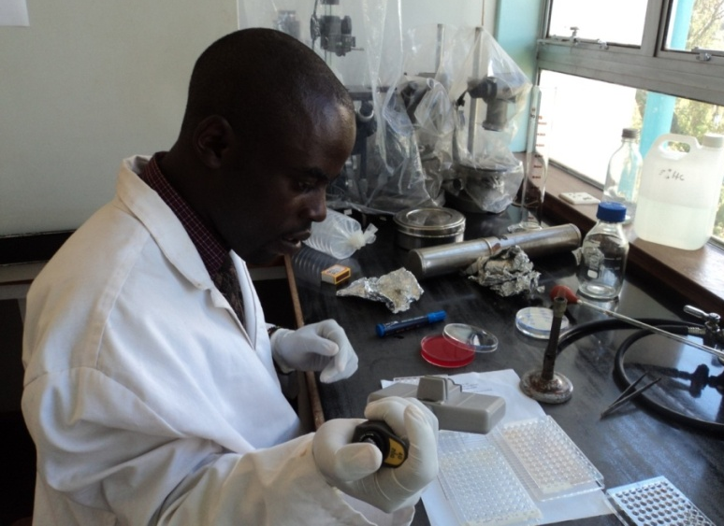
Fig 1: Some of the chickens in cages, University of Nairobi.
Fig 2: AVIVAX-F Vaccine
Fig 3: Drugs used for treatment
Fig 4: Investigator performing hemagglutination inhibition test

Slide 9
RESULTS AND DISCUSION
Pre-treatment examination results
Ectoparasites: 62.5% ecto-parasite prevalence; lice the only ecto-parasite found
Endoparasites: 100% endoparasites prevalence; tapeworms (62.5%), caecal worms (100%) and Gongylonema species (37.5%)
ND antibody titer:
Parasite findings similar to Sabuni (2009) and Maina (2005) although Sabuni documented also fleas and ticks which were not the case for this study

Slide 10
Results of ecto-parasite treated groups
At post-mortem, all birds on treatment, by dusting, of the ecto-parasites using a combination of sevin® (Carbamates) and pemethrin (Groups 2, 4, 5 and 7), had all the ecto-parasites were cleared;
While the untreated still had Ectoparasites (P<0.05).
This underscores the effectiveness of the combined drug method.

Slide 11
Results of endo-parasite treated groups
After treatment all the birds (Groups 3, 4, 6 and 7 ) had no helminths with the exception of Gongylonema inguivicola species that was embedded in mucosa of the crop while the untreated still had other helminths. meaning it has a little or no activity against this parasite .
Albendazole at a dose of 20mg/kg body weight, repeated after a month, was shown to be effective and safe against most of the helminths, both nematodes and cestodes.
This is in accordance with a finding by Tucker et al. (2007)
The drug may not have reached where the parasite was, since Gongylonema inguivicola is normally found under the mucosa of the crop; the mucosa may have protected it.

Slide 12
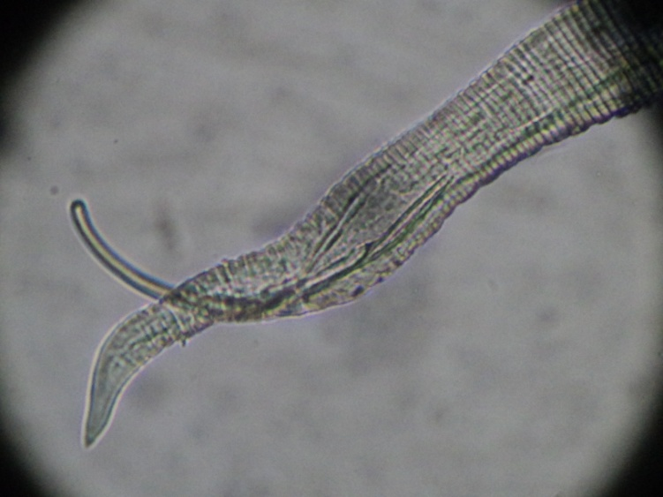
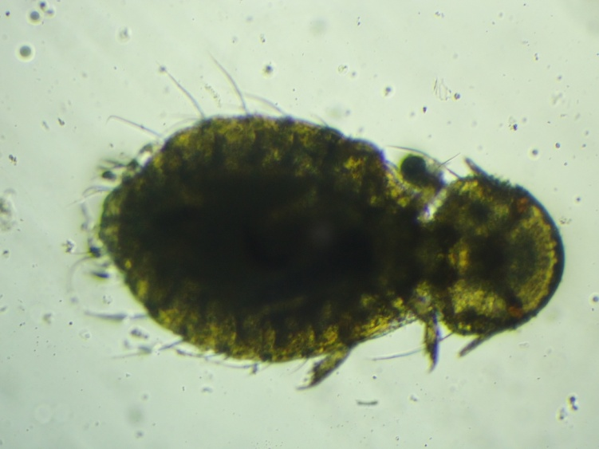
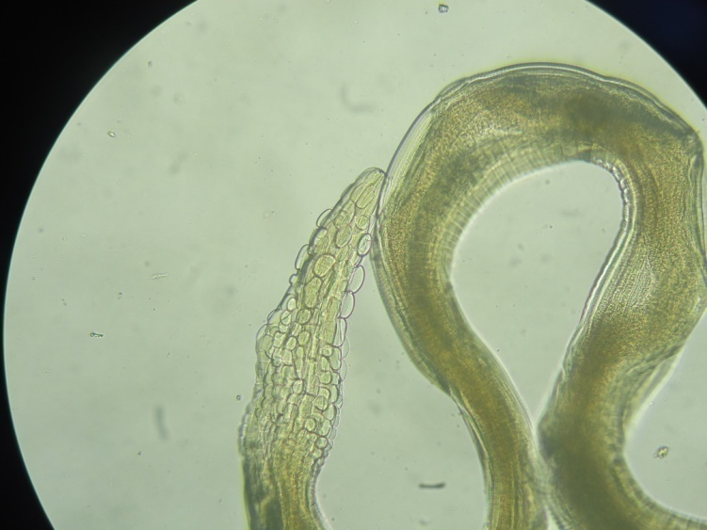
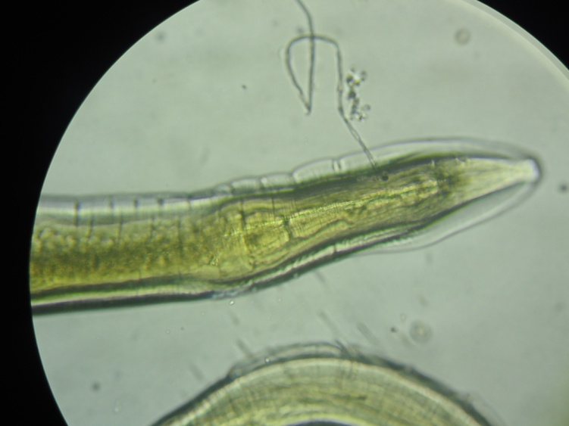
Fig 1: Heterakis isolonche
Fig 2: Goniocoites gallinae
Fig 3: Gongylonema inguivicola
Fig 4: Heterakis isolonche

Slide 13
HI test results
All the birds were positive for specific NDV antibodies pre-vaccination

Slide 15
Where treatment was done, separately or combined, the HI titre was significantly higher than that of the control birds.
Also, combined ecto- and endo-parasite treatment resulted in chickens that had significantly higher HI titres than in cases where ecto- and endo-parasite infections were treated separately.
The synthesis of immunoglobulins is reduced in animals severely affected by parasites, owing to an absolute loss in protein (Tizard, 1987).
This might result in reduced antibody response as seen in this study and that by Hǿnning et al. (2003).

Slide 16
Conclusion
This study has shown that parasite control results in improved immune response to ND vaccination by the experimental birds; total parasite treatment giving better results than partial treatments (for ecto- or endo-parasites only).
Albendazole at a dosage of 20mg/kg bwt is both safe and efficient for helminth treatment

Slide 17
Acknowledgment
The authors would like to thank J.K. Kibe, Mary Mutune and R.O. Otieno for their technical assistance, the farmers of Mbeere for their corporation, the University of Nairobi and RUFORUM for their sponsorship and funding of the project

