Slide 1
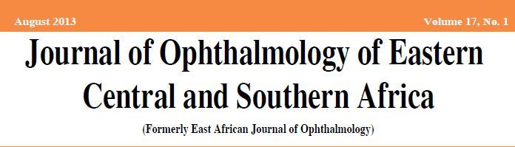
RESEARCH AND PUBLICATION IN ECSA REGION
Dr E M Nyenze
Editor in Chief
JOECSA

Slide 2
How much research is going on in ECSA region?
What types of studies are being conducted in the region?
What proportion of these studies are being published?
Where are these papers published?
How many ophthalmologists access papers published from the region

Slide 3
How much research?
A lot- in all teaching institutes, all postgraduate students must write a thesis
Most lecturers do their own research apart from supervising post graduate students
Outside teaching institutes, some ophthalmologist do especially clinical research and clinical audits
There’s however a challenge because of work load and lack of resources

Slide 4
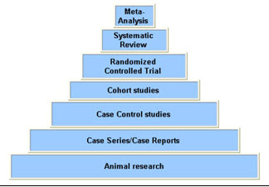
Types of studies?
Mainly observational studies
Gaps on experimental studies

Slide 5
publications
Most of the studies in the region are not published
Most researchers want to publish in high impact journals
High rejection of regional papers
Largest challenge is not methodology but relevance

Slide 6
Who publishes in JOECSA
16 Papers in 2013
Kenya 9
Ethiopia 4
Uganda 2
UK 1

Slide 7
Why should we promote JOECSA
Access – free access online and on print
Portal for publication of papers of regional importance
Supportive review process
Chance to elevate our own journal to international standards

